Slide 1
Object Oriented Programming I: Lecture 1
Ahmed Imteaj
Lecturer
Dept. of CSE, IIUC

Slide 2
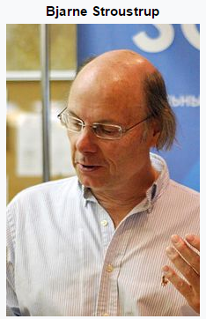
Why Do We Need Object-Oriented Programming?
In the early 1980's, also at Bell Laboratories, a programming language was created which was based upon the C language.
This new language was developed by Bjarne Stroustrup and was called C++.
Object-oriented programming was developed because limitations were discovered in earlier approaches to programming.

Slide 3
Problems with Structured Programming
As programs grow ever larger and more complex, even the structured programming approach begins to show signs of strain.
Analyzing the reasons for these failures reveals that there are weaknesses in the procedural paradigm itself.
No matter how well the structured programming approach is implemented, large programs become excessively complex.
What are the reasons for these problems with procedural languages?
There are two related problems.
First, functions have unrestricted access to global data.
Second, unrelated functions and data, the basis of the procedural paradigm, provide a poor model of the real world.

Slide 4
What is a Procedural Language?
A procedural language is a type of computer programming language that specifies a series of well-structured steps and procedures within its programming context to compose a program.
It contains a systematic order of statements, functions and commands to complete a computational task or program.

Slide 5
What is a Procedural Language?
Each statement in the language tells the computer to do something: Get some input, add these numbers, divide by six, display that output etc.
A program in a procedural language is a list of instructions.
C, Pascal, FORTRAN, and similar languages are procedural languages.

Slide 6


Simple Comparison between OOP and Procedural Programming
A simple way to compare both programming methods is to think of Object-oriented Programming as learn to read picture book.
As children see pictures of simple objects like a house or picture they know that throughout the book when they see a picture of the house it represents the word house.
The children can then read through the book as words are substituted throughout the story with pictures.

Slide 7
Simple Comparison between OOP and Procedural Programming
In Object-oriented Programming the classes could represent the pictures in the learn to read books. A house could represent a class and anything the developer wants to have included to describe that house like the color, size, number of bathrooms etc.
In Procedural Programming the learn to read book would be words on the page without pictures to help guide the young learner through the book. If the story was changed in the beginning of the book it could disrupt or make the story later on in the book not make any sense. Although learning to read the book would make programming with Procedural Programming simple, it would make it difficult for other readers in the case of the book or programmers in the case of Procedural Programming to add to the story.

Slide 8
What is OOP?
Object-oriented programming (OOP) is a programming paradigm based on the concept of "objects", which may contain data, in the form of fields, often known as attributes; and code, in the form of procedures, often known as methods.

Slide 9
What is C++?
C++ is a middle-level programming language developed by Bjarne Stroustrup starting in 1979 at Bell Labs.
C++ runs on a variety of platforms, such as Windows, Mac OS, and the various versions of UNIX.

Slide 10
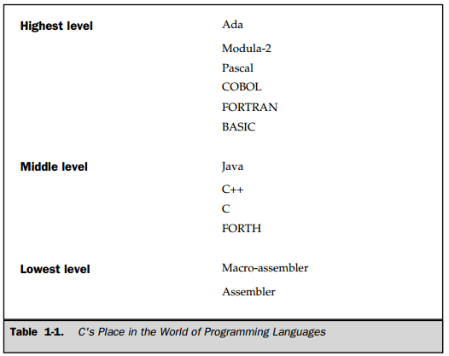

Slide 11
C++ Console I/O
#include <iostream>
using namespace std;
int main()
{
int a;
cin>>a;
cout << "Hello World“<<a;
return 0;
}

Slide 12
Introduction to Classes
The classes are the most important feature of C++ that leads to Object Oriented programming.
Class is a user defined data type, which holds its own data members and member functions, which can be accessed and used by creating instance of that class.
In the real world, you'll often find many individual objects all of the same kind.
For example, There may be thousands of other bicycles in existence, all of the same make and model. Each bicycle was built from the same set of blueprints and therefore contains the same components.

Slide 13
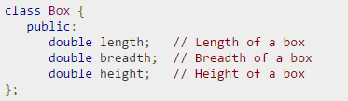

Introduction to Classes
A class definition starts with the keyword class followed by the class name; and the class body, enclosed by a pair of curly braces. A class definition must be followed either by a semicolon or a list of declarations. For example, we defined the Box data type using the keyword class as follows:

Slide 14
Introduction to Objects
Defining an object is similar to defining a variable of any data type.
An object is an instance (that is, a specific example) of a class. Objects are sometimes called instance variables.

Slide 15
Program: Classes and Objects
#include <iostream>
using namespace std;
class smallobj //define a class
{
private:
int somedata; //class data
public:
void setdata(int d) //member function to set data
{ somedata = d; }
void showdata() //member function to display data
{ cout << “Data is “ << somedata << endl; }
};
int main()
{
smallobj s1, s2; //define two objects of class smallobj
s1.setdata(1066); //call member function to set data
s2.setdata(1776);
s1.showdata(); //call member function to display data
s2.showdata();
return 0; }

Slide 16
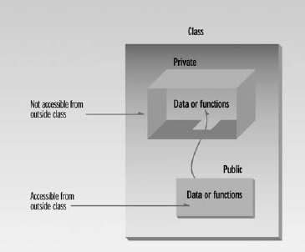
Private and Public

Slide 17
Difference between C and C++
C
C++
C was developed by Dennis Ritchie between 1969 and 1973 at AT&T Bell Labs.
C does not support object oriented programming; therefore it has no support for polymorphism, encapsulation, and inheritance.
C does not have namespace feature.
C uses functions for input/output. For example scanf and printf.
C does not support reference variables.
C has no support for virtual and friend functions.
C++ was developed by Bjarne Stroustrup in 1979
Being an object oriented programming language C++ supports polymorphism, encapsulation, and inheritance.
C++ uses NAMESPACE which avoid name collisions.
C++ uses objects for input output. For example cin and cout.
C++ supports reference variables
C++ supports virtual and friend functions.

Slide 18
Difference between Structured Programming and OOP
Self

Slide 19
Benefits of OOP
The main advantages are
It is easy to model a real system as real objects are represented by programming objects in OOP. The objects are processed by their member data and functions. It is easy to analyze the user requirements.
With the help of inheritance, we can reuse the existing class to derive a new class such that the redundant code is eliminated and the use of existing class is extended. This saves time and cost of program.
In OOP, data can be made private to a class such that only member functions of the class can access the data. This principle of data hiding helps the programmer to build a secure program that can not be invaded by code in other part of the program.
With the help of polymorphism, the same function or same operator can be used for different purposes. This helps to manage software complexity easily.
Large problems can be reduced to smaller and more manageable problems. It is easy to partition the work in a project based on objects.

Slide 20
Characteristics of Object Oriented Programming
The principal features of OOP are:
1. Encapsulation
2. Abstraction
3. Inheritance
4. Polymorphism

Slide 21
Characteristics of Object Oriented Programming
Data encapsulation is a mechanism of Creating a class by combining object’s attributes and behaviors.
Data abstraction is a mechanism of exposing only the interfaces and hiding the implementation details from the user.

Slide 22
Characteristics of Object Oriented Programming
Inheritance is probably the most powerful feature of object-oriented programming, after classes themselves.
Inheritance is the process of creating new classes, called derived classes, from existing or base classes.
The derived class inherits all the capabilities of the base class but can add embellishments and refinements of its own. The base class is unchanged by this process.

Slide 23
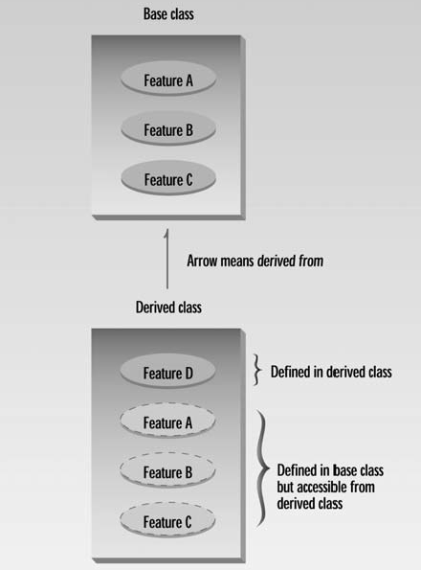
Characteristics of Object Oriented Programming
The inheritance relationship is shown in Figure 9.1.

Slide 24
Characteristics of Object Oriented Programming
Polymorphism means that some code or operations or objects behave differently in different contexts.
For example, the + (plus) operator in C++:
4 + 5 <-- integer addition
3.14 + 2.0 <-- floating point addition
s1 + "bar" <-- string concatenation!
In C++, that type of polymorphism is called overloading.

Slide 25
Application of Object Oriented Programming
Main application areas of OOP are
Real Time Systems
Simulation and Modeling
Client-Server System
Object oriented databases
AI and Expert System
Neural Networks and parallel programming
Decision support and office automation system etc.

Slide 26
Thank You!!

